Slide 1
Network Programmability as a Cloud Service
Deepanshu Lulla Anuj Tyagi
Akshay Battaje Amey Uchagaonkar
Mentor: Dr. Somaya Arianfar

Slide 2
PROJECT OVERVIEW
Goals
Offer Network Programmability as a service
Solving problem of scaling across multiple IaaS providers
Users
Infrastructure as a Service (IaaS) providers
End Product
Provide APIs to IaaS providers

Slide 3
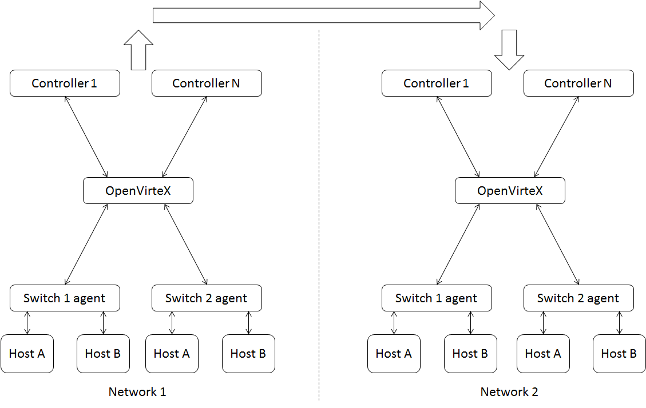
Proposed Project Architechture
Please change switch 1 agent to switch 1(only).
There is nothing like a switch 1 agent.
Also below it is not network 1 and network 2 .It is AS1 and AS2
Also change hostnames from host a and host b to different host names,same for switches
Clarification:
Switch1 has its own network so does switch2 and so does switch 3 and 4.
AS1 consists of networks with switch1 and switch 2 AS2 consist of networks from switch 3 and 4
AS1 and AS2 will be different VMs in our setup

Slide 4
Sprint 1
Create a simple network topology in Mini net
Send packets across multiple OpenvSwitches using Opendaylight controller

Slide 5
Mininet

Slide 6
Open Flow

Slide 7
Open virtual switch

Slide 8
Controller

Slide 9
Why open daylight?

Slide 10
Sprint 1:Creating a network
10.2
Controller
Switch 1
Switch 2
Switch 3
Host
A
Host
B
Host
C
10.0.0.1
10.0.0.2
10.0.0.3

Slide 11
NETWORK CONTROL AND DATA PLANE SHARING
Concerns:
Switches shared and controlled by multiple cloud providers
Who manages what
Who interacts with whom
Minimal infrastructure to support
Offer network resources and control as independent service
Full partioning/virtualization of network resources
Notes:
I am nor sure why this slide is there?

Slide 12
DEMO

Slide 13
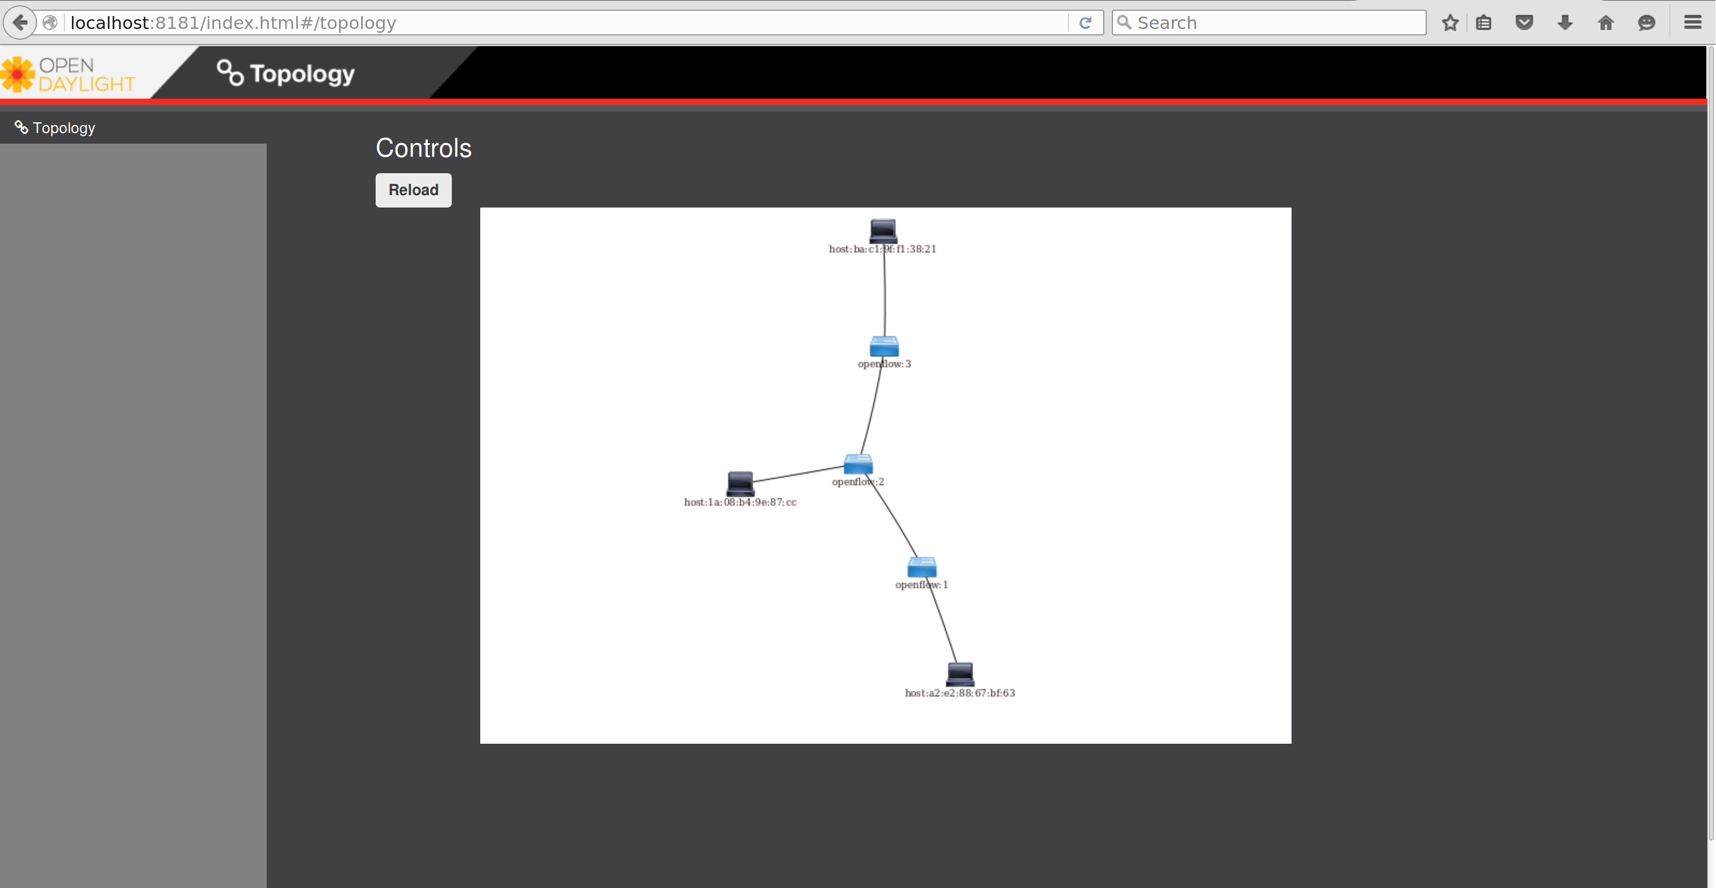
$sudo mn --controller=remote,ip=127.0.0.1 --topo=linear,3

Slide 14
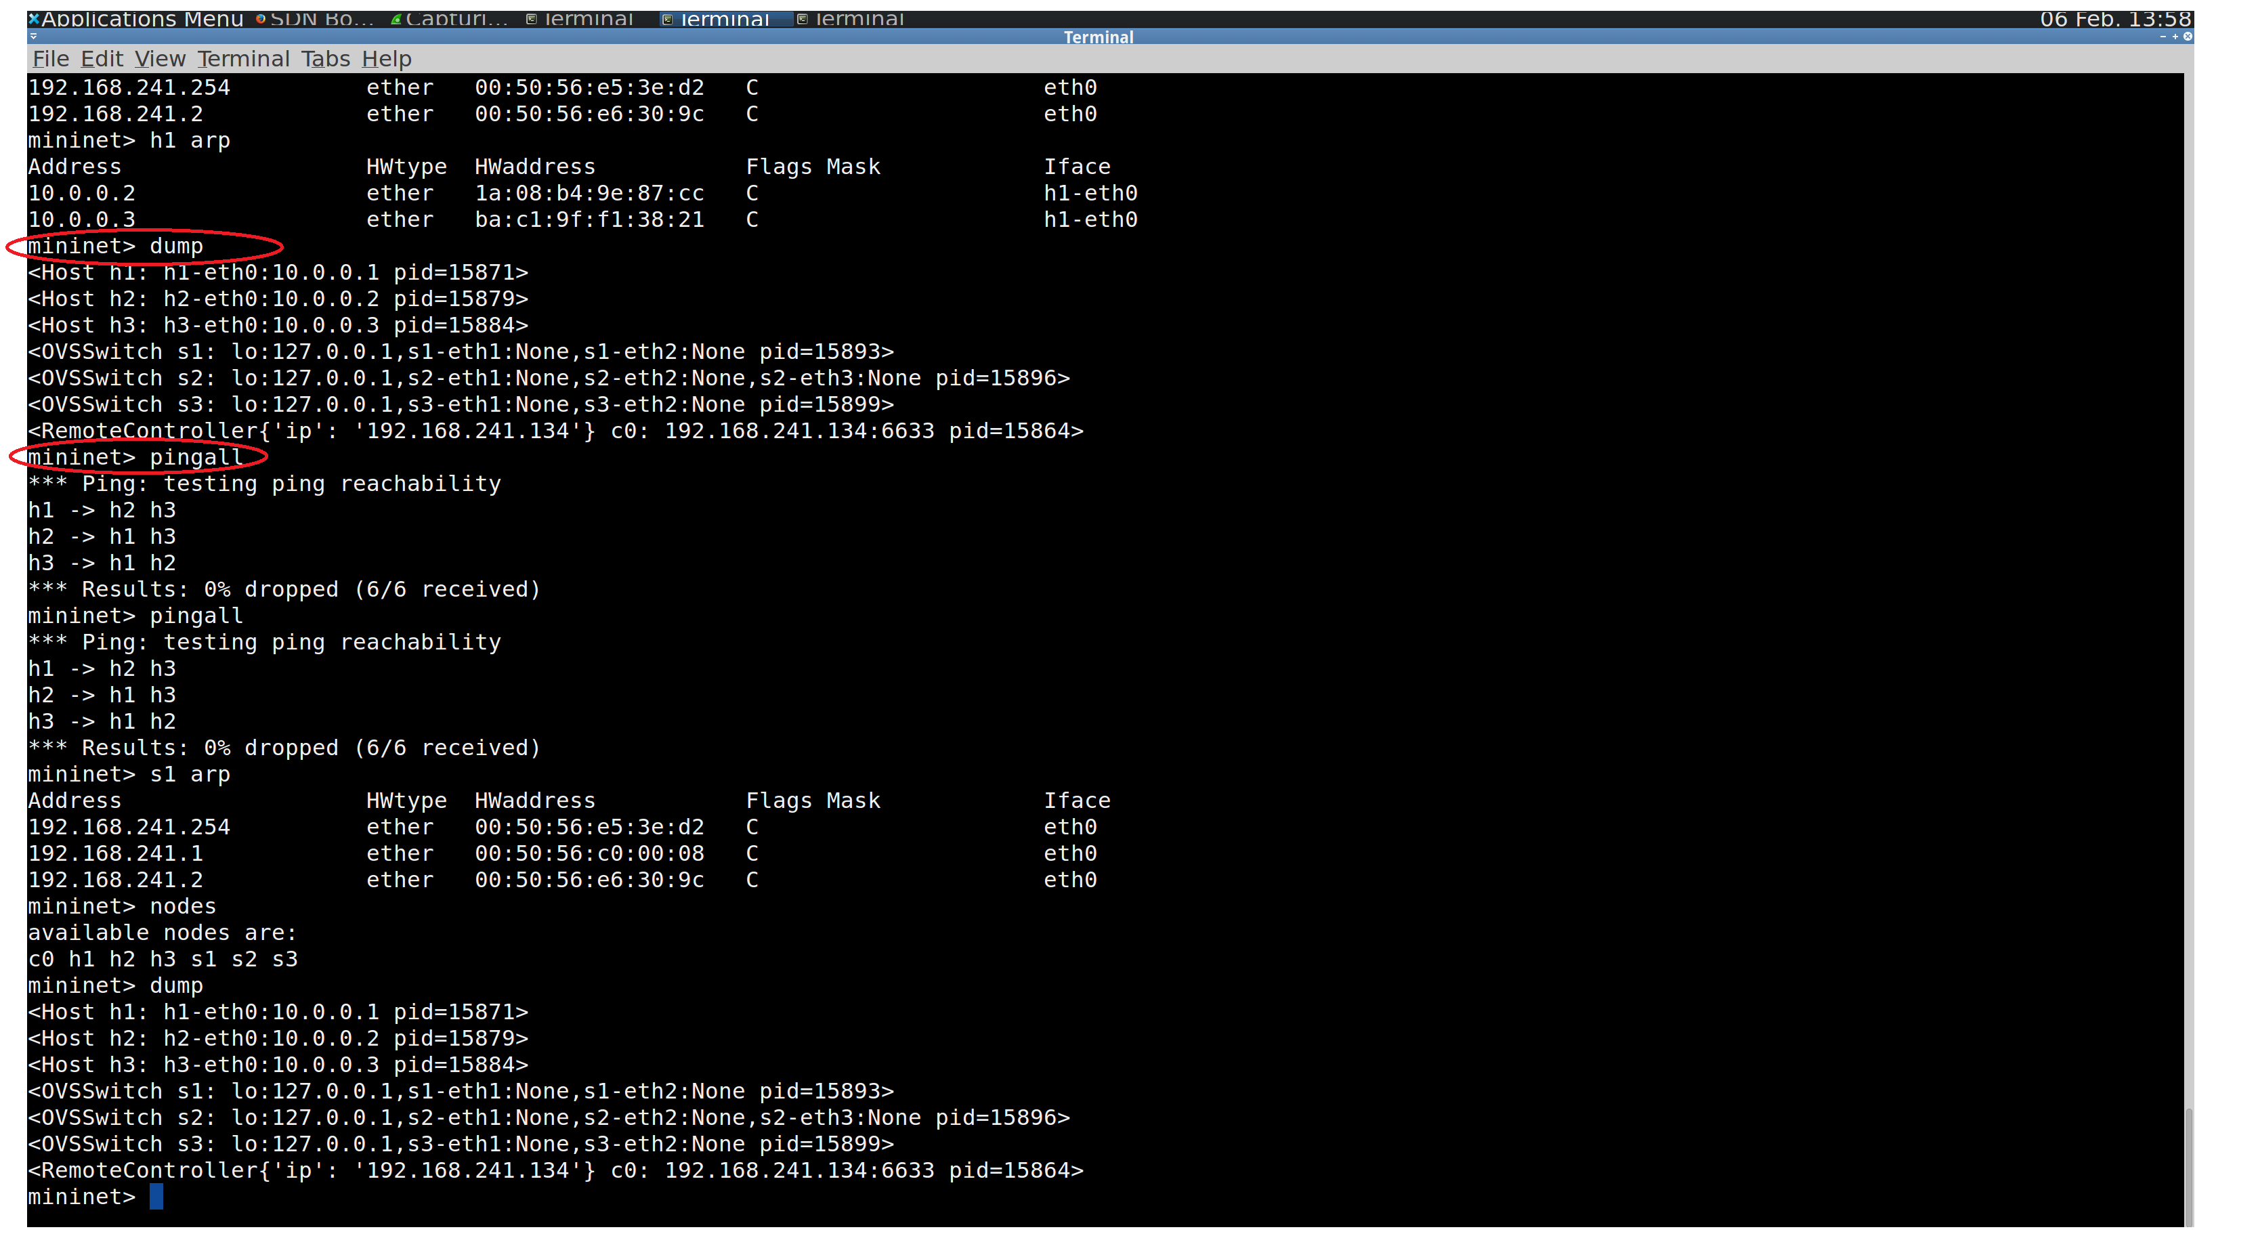

Slide 15
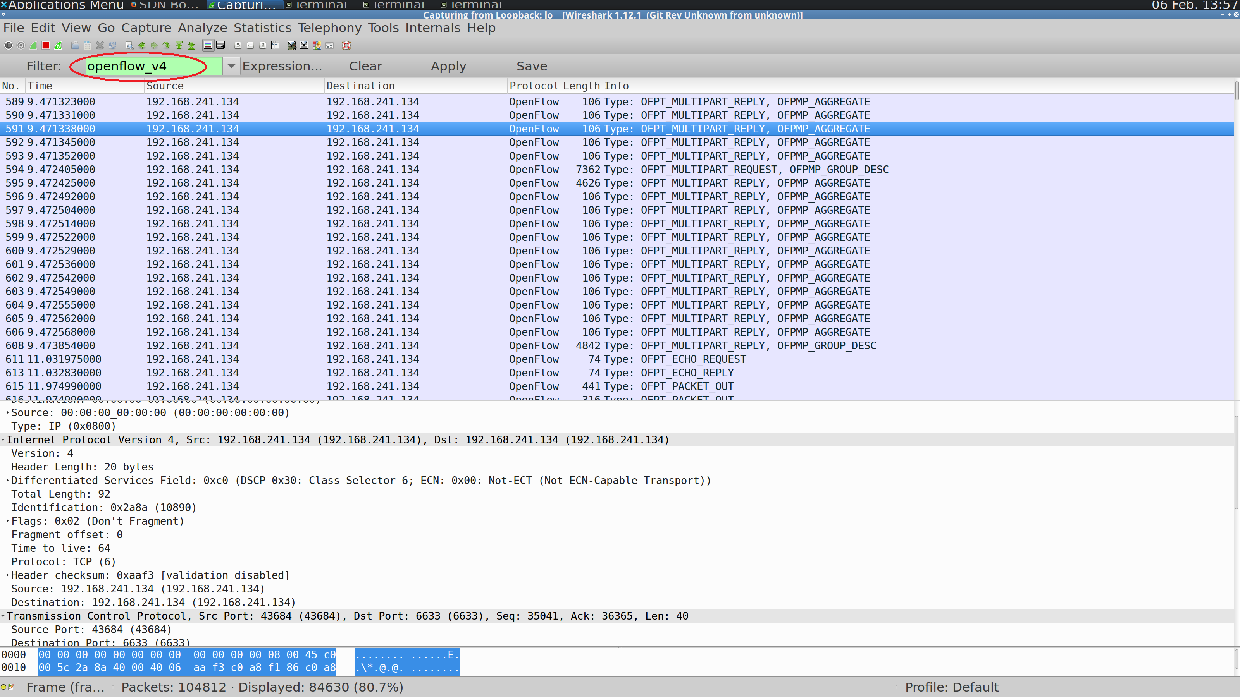

Slide 16
Analysis of packets

Slide 17
SPRINT 2
Configure learning switch with OpenDaylight
Add flows and flow table using OpenFlow in OVS.
Create administrative domain with multiple networks
Connect the multiple networks in current topology

Slide 18
Sprint 2:Scaling to multiple networks
Controller
Switch 1
Switch 2
Switch 3
Switch 4
Host
A
Host
B
Host
C
Host
D
Subnet 1
Subnet 2

Slide 19
QUESTIONS?

